Slide 1

Implementation of SparkR within PDC
Insert
Insert Author: Ahmed, Ifraz
Notes:
Title Slide should include a brief title, subtitle, and presenter information. There is placeholder copy set to the IRS design standards. To update the content simply click on the text or within a box and start typing or right click to paste copy from another source. If there is an area you do not wish to print, either leave the placeholder copy or click within the box and hit the space bar to remove it.
The Product ID line in the footer of the title slide can be deleted if not needed.

Slide 2
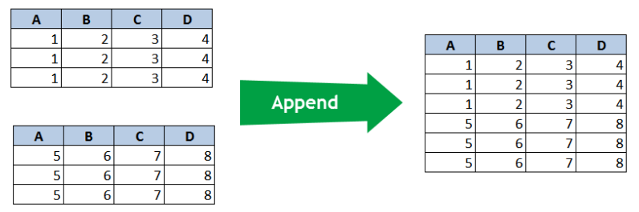
Introduction
Background of PDC
PDC (Private Debt Collection) is a program within the IRS to collect outstanding taxes owed using PCAs (Private Collection Agencies).
The purpose of the RAAS PDC program is to enable and inform programmatic decision-making through strategic and analytical support.
Data collection within PDC started in April 2017, and are appended to the Entity History Table (EHIST).
The amount of data recently outgrew the resources available, creating a need for a big data solution.
Notes:
How big is big?
How many records in EHIST table
How many records trying to add each cycle
Gives a better idea of what we’re doing

Slide 3
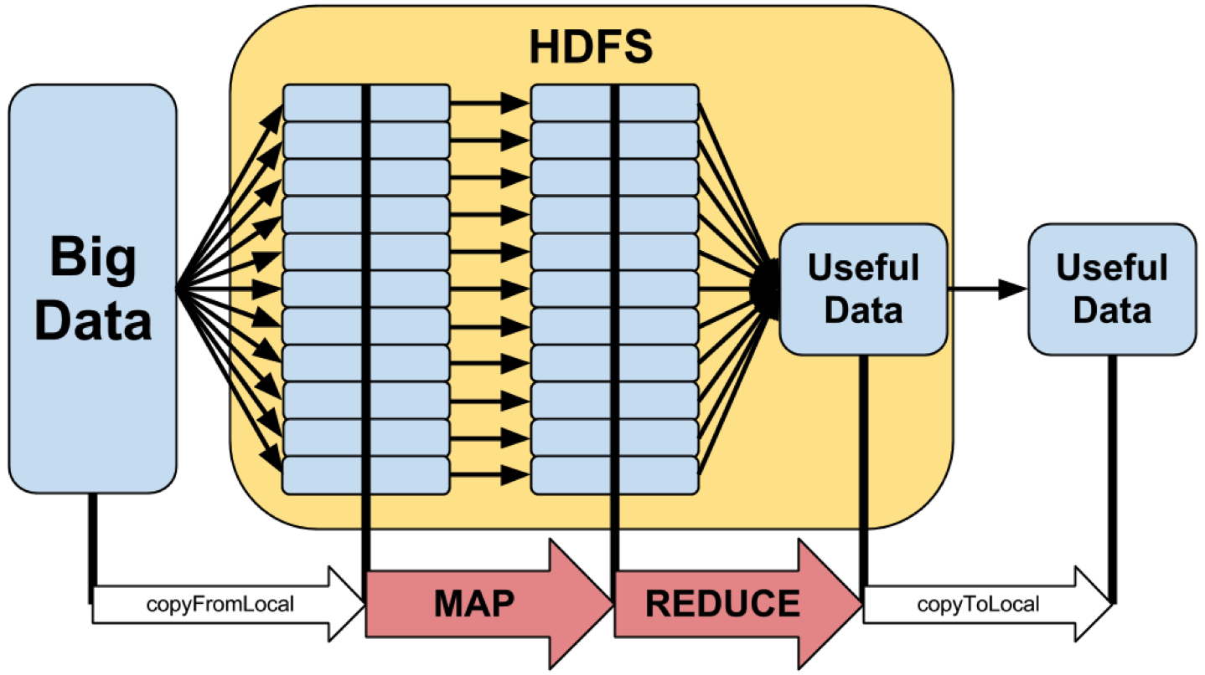
Introduction
Background of SparkR
SparkR is the implementation of the R programming language within the Hadoop Ecosystem.
Like other Hadoop technologies, SparkR leverages the MapReduce framework for computational power and HDFS (Hadoop Distributed File System) for storage.
HDFS stores data through distribution, meaning data are partitioned and replicated throughout the Hadoop cluster for reliability and redundancy.
MapReduce processes data in parallel by partitioning large data sets into manageable chunks and processing each chunk simultaneously.

Slide 4
Data Organization
CDDB (Custodial Detail Database)
Contains Entity and Module (EHIST & MHIST) tables.
Used for entity and module level information, PNI (Potential New Inventory), assigned cases, and financial transaction data.
~2.7 million rows of fresh data are appended to the EHIST table every cycle (week).
The EHIST_202124 file is ~321 million rows.
Moving files between [REDACTED] and R could take up to 48 hours.
After additional resources were allocated, time went down to 24 hours.
Notes:
Don’t know what spouse TINs are.
Ehist and mhist information contains data from when PDC program started, appended each cycle
Talk about why ehist and mhist tables are so big – we aren’t deleting anything – amount of gb
Where data is located – mercury, transfer from [REDACTED]to Hadoop
Append weekly files into big ehist table

Slide 5
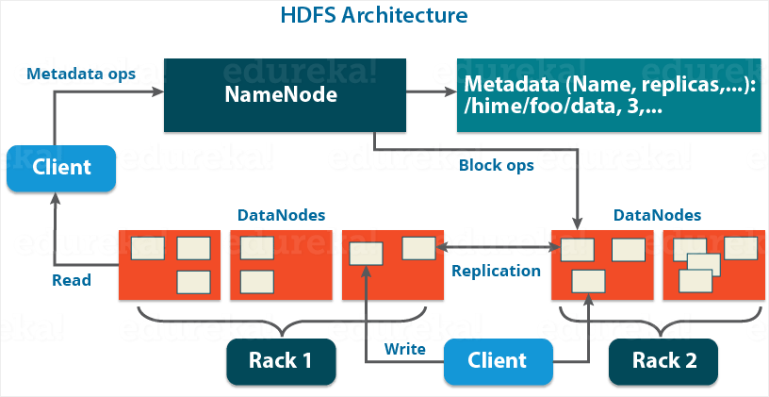
Data Organization
HDFS
Uses a master-slave architecture where the NameNode (master) knows where the data are in the cluster while the DataNode (slave) stores the actual data.
Data are partitioned in 128 MB blocks and distributed twice – total of three copies.
Access HDFS using SecureCRT connected to the EdgeNode.
Interact with HDFS using UNIX with the prefix ‘hdfs dfs’ or ‘hadoop fs’ before each command.
‘scp’ command is used to move files between [REDACTED] server and HDFS.

Slide 6
ETL
EXTRACT
Extract files from [REDACTED] server to the EdgeNode using scp.
Ingest files from HDFS to SparkR by specifying the file format and path in HDFS.
TRANSFORM
After files have been ingest, transform the dataset into a structure relevant to the analysis.
Examples of transformation functions in SparkR include unionAll, groupBy, join, and filter.
LOAD
Finally, after the analysis has been performed, load the data into the target directory using write.df
Move files from the EdgeNode to HDFS using copyFromLocal.

Slide 7
Obstacles and Solutions
Connecting SparkR to CRAN
Obstacle: IRS firewall blocked SparkR from connecting to CRAN -- the repository where R packages are downloaded.
Solution: Changed the default CRAN location to the CRAN mirror located within the IRS firewall at https://10.207.92.200 by modifying the main.R file.
Connecting SparkR to HDFS
Obstacle: Unable to ingest files from HDFS due to the SparkContext environment not being created. This issue was especially tricky because the code would intermittently run with no modifications being made to the script.
Solution: SparkR was loading the incorrect package version (2.3.0) instead of correct (2.4.5). Needed to specify where the correct package is located after removing earlier versions.
Ingesting .rds Files
Obstacle: The team and I discovered SparkR does not have functionality for ingesting .rds files at the time of the latest release.
Solution: Converted .rds file to .csv and ingested the .csv file. Not a permeant solution but a decent workaround until the functionality is added.

Slide 8

Thank You RAAS Team 3
Anderson, Quinton
Dr. Bartels, Rudy
DiDomenico, Mario
Lindsay, Yvonne
Stanton, Mark
Thank you, Team 3, for your support, patience, mentorship, and humor while we worked on this project.

Slide 9
References
RAAS_PDC_Desk_Guide
https://spark.apache.org/docs/latest/api/R/index.html
https://hadoop.apache.org/docs/current/hadoop-project-dist/hadoop-hdfs/HdfsDesign.html

